Slide 1
TITLE
DROWSINESS DEETCTION USING OPEN CV FACE RECOGNIZATION

Slide 2
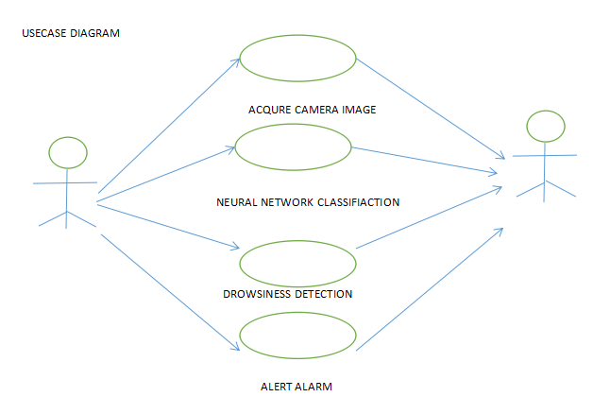
USECASE DIAGRAM

Slide 3
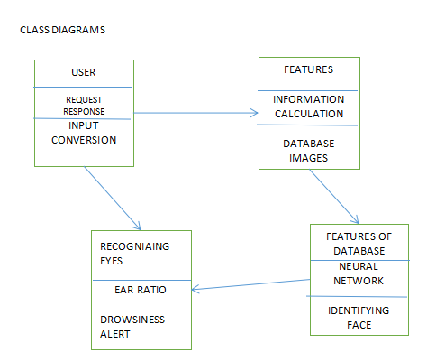
CLASS DIAGRAM

Slide 4
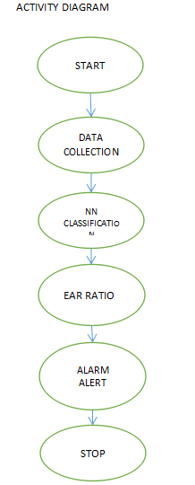
ACTIVITY DIAGRAM

